Slide 1
Project 3-Phase 4
Simulation of A* algorithm on a differential drive (non-holonomic) mobile robot
Deadline – April 10, 11.59PM

Slide 2
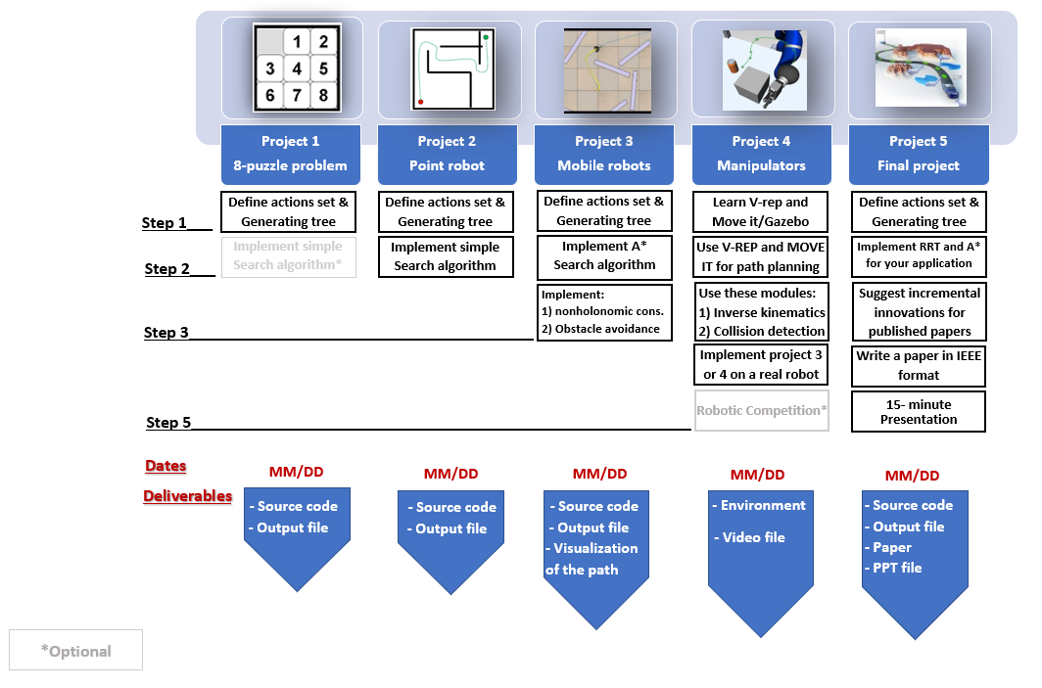
Project3

Slide 3
Project description
Simulate the path planning implementation from Project 3- Phase 3 in either VREP or Gazebo.
Gazebo environment has been provided for the map (map.world file)
VREP environment needs to be created similar to the map provided with the help of in-built objects.

Slide 4
Inputs from the User
Your code must take following values from the user:
Start Point Co-ordinates (3-element vector – x, y, theta)
Goal Point Co-ordinates (2-element vector – x, y)
Wheel RPMs (2-element vector) => Two possible values for the wheel RPMs
Clearance

Slide 5
Parameters to be Defined
Your code must take the following parameters into consideration:
Robot Diameter (from the datasheet)
Wheel Distance –L (to be computed using the datasheet)
Reasonable Clearance
Note that, these parameters are not defined by the user. These are the parameters you need to consider while developing the code.

Slide 6
Important pointers
To run the simulation in ROS, you should have everything wrapped in only one launch file. For VREP, you should have one main script to run.
Make note of the coordinate system in Gazebo, and the position of the origin. Input will be based on the coordinates in Gazebo.
User input should be from Terminal.
Only one person has to submit the final zip folder. Mention the other teammates in the comments section.
Mention the GitHub Repository's link in the comments section as well.

Slide 7
Helpful links for ROS
Writing a publisher/subscriber node –
http://wiki.ros.org/ROS/Tutorials/WritingPublisherSubscriber%28python%29
Initialize robot pose - https://answers.ros.org/question/40627/how-do-i-set-the-inital-pose-of-a-robot-in-gazebo/
Load custom Gazebo environment/ Creating ROS package - http://gazebosim.org/tutorials?tut=ros_roslaunch

Slide 8
Deliverables
There is weightage w.r.t to following instruction for folder name, directory structure, one launch file(ROS)/script (VREP) etc.
Source code
GitHub (one repository link only) and ReadMe
Simulation results (video of the simulation)
‘Video1’
‘Video2’
* Details for the videos are mentioned in the next slides

Slide 9
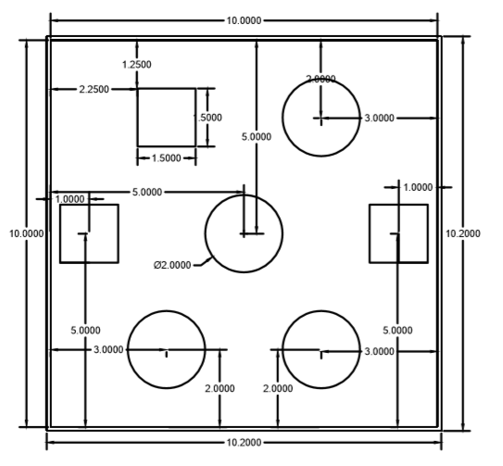
Video1
The approximate start point is shown in red and goal point is shown in green.
The video should show the Turtlebot motion in Gazebo environment for these points.
Choose the points by your best judgment along with other user inputs.
You are not required to implement a controller, this will be open-loop and hence, it is okay if the robot does not follow the exact waypoints.

Slide 10
Video2
The approximate start point is shown in red and goal point is shown in green.
The video should show the Turtlebot motion in Gazebo environment for these points.
Choose the points by your best judgment along with other user inputs.
You are not required to implement a controller, this will be open-loop and hence, it is okay if the robot does not follow the exact waypoints.

